Slide 1
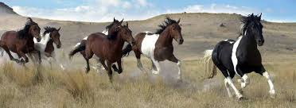
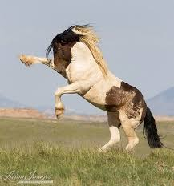
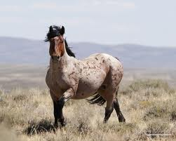
Wild Mustangs!!!
By: Paige Hayes

Slide 2
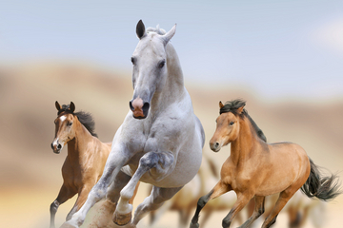
Description of the Mustang.
Horses/ mustangs belong to the genus Equus, which originated in North America about 4 million years ago.
Mustangs are descendants of Spanish, or Iberian, horses that were brought to the Americas by Spanish explorers in the 16th century.
The name was comes from the Spanish word mustengo, which means "ownerless beast" or "stray horse.
These horses bred with other types of horses, including quarter horses and draft horses, to create the breed we know today.
Native Americans soon used these horses for transportation. Pioneers liked these horses because they have fantastic strength and speed.

Slide 3
Mustang Facts!!!
Mustangs do not achieve their full adult size until they are 4 to 7 years old.
Wild horses can live up to 40 years old.
Weight varies with height, but most are around 700 to 800 pounds.
The wild appaloosa has descended from spotted Spanish horse. Many herds also include horses of palomino coloring, a breed also originating from Spain. Wild paints, also known as pintos. More colors include dark brown, blue-gray, and a buckskin-colored coat with black points.
The scientific name for a Wild Mustang is Equus caballus.
Mustangs are located in these ten western states: Nevada, Wyoming, Utah, Oregon, California, Idaho, Arizona, Montana, North Dakota and New Mexico.

Slide 4
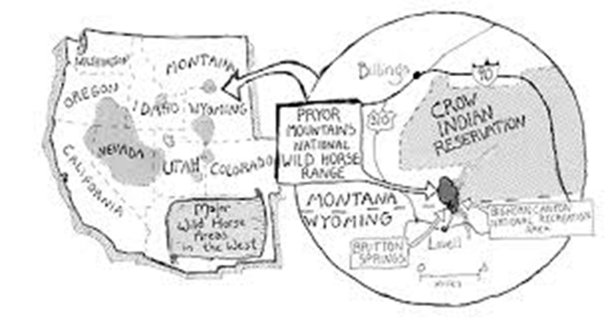
More Facts of the Mustang!!!
The Bureau of Land Management manages the U.S. mustang population and allows the horses run free on 34 million acres of public land.
About 271,000 mustangs have been removed from private land by the government since 1971, according to the American Wild Horse Preservation Organization.
A male mustang and a domesticated male horse go by the same two descriptions, such as Stallion and Gelding.
A female mustang and a domesticated female horse also go by the same description, such as a Mare.
Baby mustangs are called fouls and baby males are called colts.
Aslo baby females are called fillys.

Slide 5
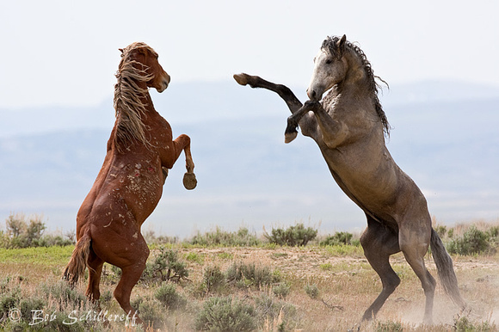
Mustangs Lifecycle!!!
The life cycle of a horse is 30 to 40 years.
Mustangs are small and smaller than most horses.
Wild horses mate and foal in mid to late spring.
The gestation period lasts for about 11 months, or about 340 days.
Most mares foal at night or early in the morning, and prefer to give birth alone when possible.

Slide 6
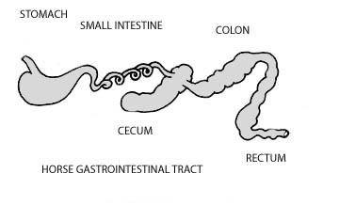
Habitat and Diet!!!
Mustangs are free-roaming horses of the American and Canadian deserts and plains.
The food of choice for all horses is grass.
Wild Mustangs get their food by grazing in the medows.
A wild horse will graze up to 18-20 hours a day while domesticated horses average about 9-14 hours. During that time the average horse consumes about 30 pounds of all different types of grasses.
A mountain lion is a preditor to the wild mustangs.

Slide 7
3 unique facts about the Wild Mustang!!!
The Mustang horses that rambled across the North American grasslands in prehistoric times. At the end of the last ice age nearly 12,000 years ago, the Mustang population was wiped out from the American land.
Towards the beginning of the 20th century, Mustangs were hunted for pet food, however, the 1971 act was passed to protect these lovely horses.
Mustangs were declared as the “living symblos of the historic and pioneer spirit of the west”, by the U.S. Congress in 1971.

Slide 8
Worked Sited Page!!!
www.livescience.com/mustangs
www.eduscapes.com/nature/mustang/index1.htm
www.wikipedia.org/wiki/mustang
www.kbrhorse.net/wclo/blmc04.html
www.cherryweb.com/msippl/mustang.htm
www.wikipedia.org/wiki/Horse_breeding
www.hswlt.org/wildlif/close-ups-/mustang-wildlife-close-up.html
www.animals.pawnation.com/wild-mustangs-diet-5094.html
www.hganham.triped.com/Horses/horses36.html
www.buzzel.com/articals/mustang-horse-facts.html

